Slide 1
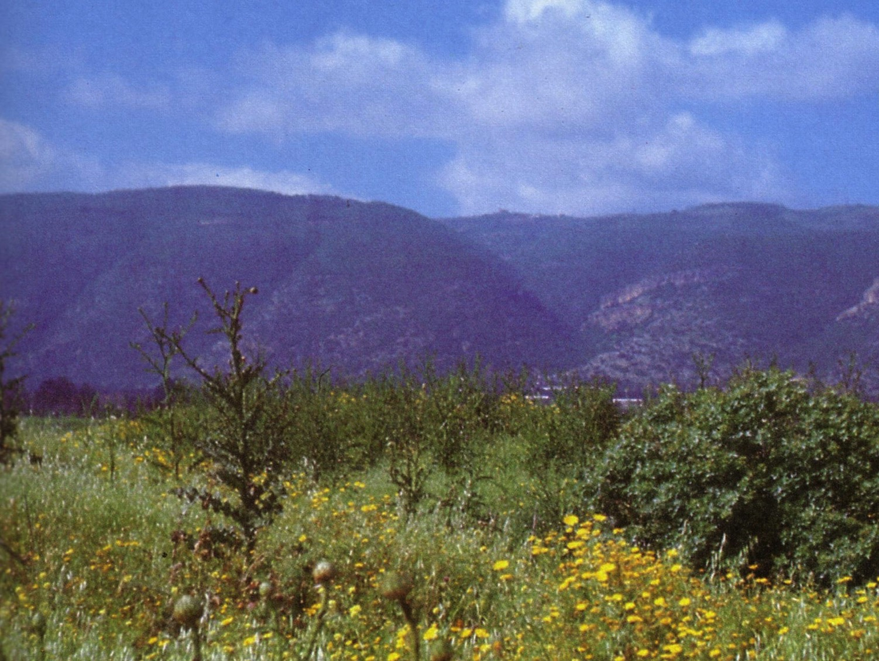
Pagan Religions
150
Backgrounds to the New Testament
Mount Carmel arises from the Jezreel Valley where Elijah met the pagan religions of his day
Dr. Rick Griffith • Jordan Evangelical Theological Seminary • BibleStudyDownloads.org

Slide 2
Acts 1-8 Map
29
150
Spread to Gentiles
"But you will receive power when the Holy Spirit comes on you; and you will be my witnesses in Jerusalem, and in all Judea and Samaria and to the ends of the earth" (Acts 1:8)

Slide 3
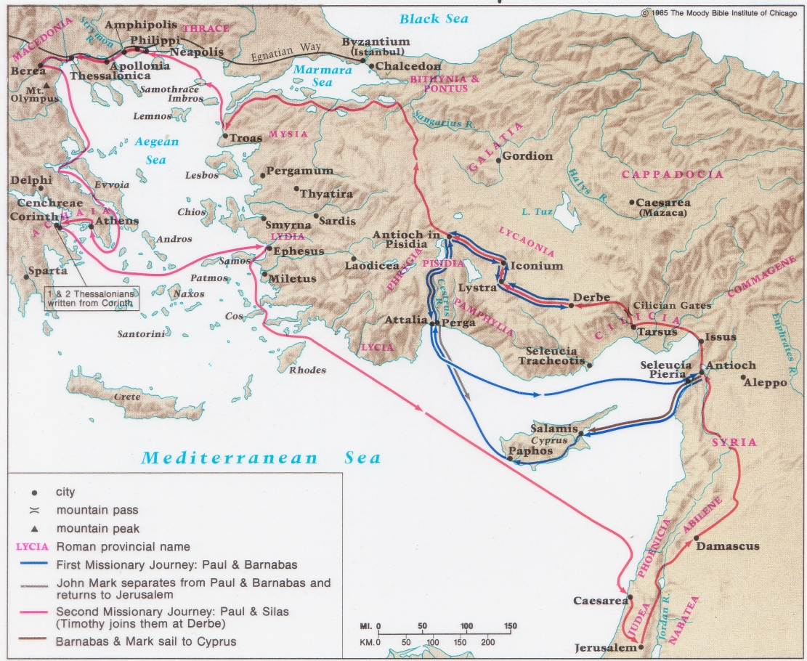
Paul's First & Second Missionary Journeys
30
150

Slide 4
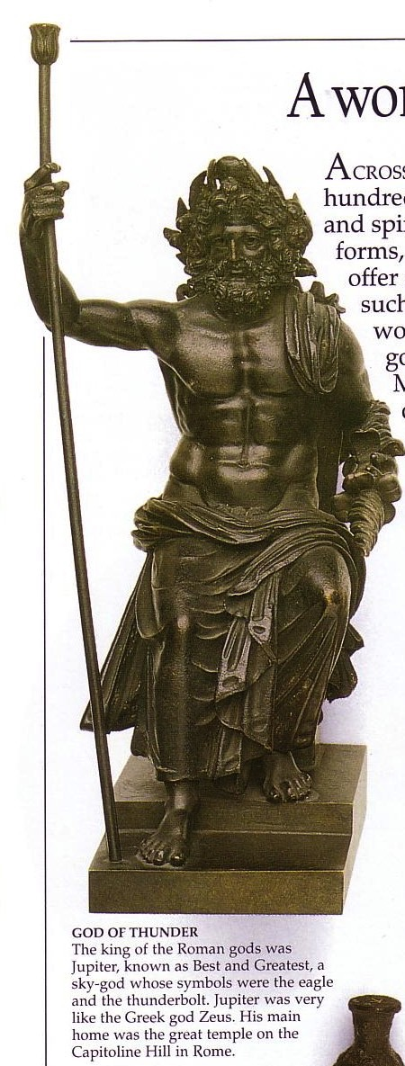
Pagan Religions
150
Types of Gentile Belief Systems
Traditional Pagan Religion
Schools of Philosophy
The Emperor Cult
Mystery Religions
Astrology & Superstition
Gnosticism

Slide 5
Pagan Religions
150
Types of Gentile Belief Systems
Traditional Pagan Religion

Slide 6
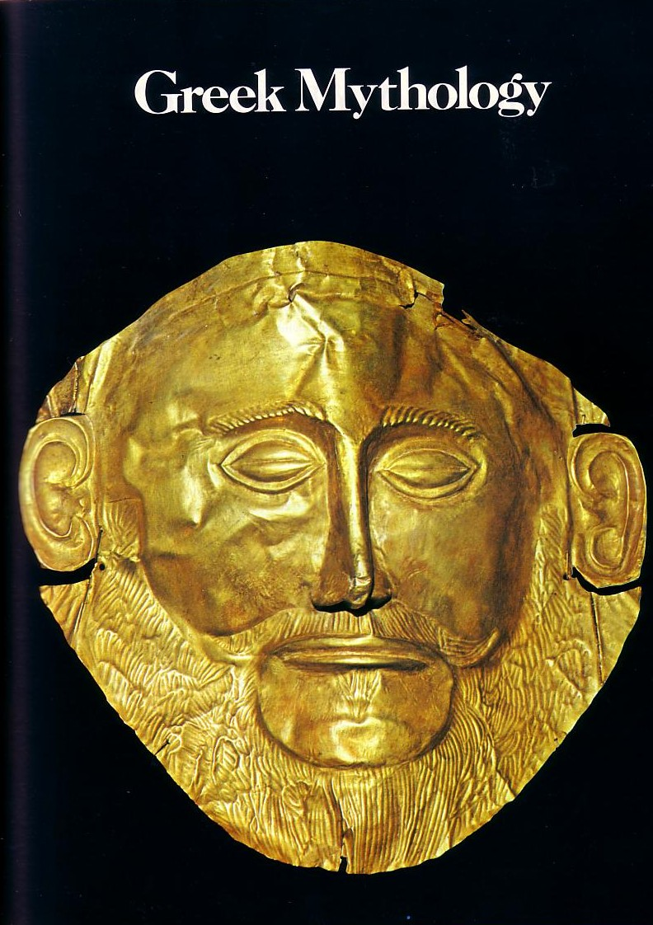
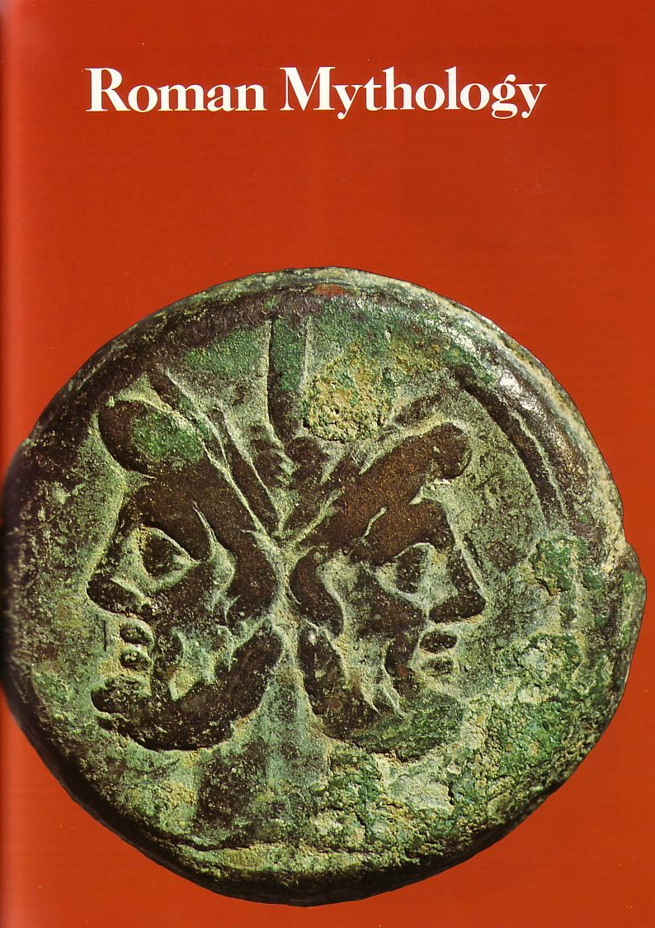
Greek & Roman Mythology
Greek Mythology
Roman Mythology

Slide 7
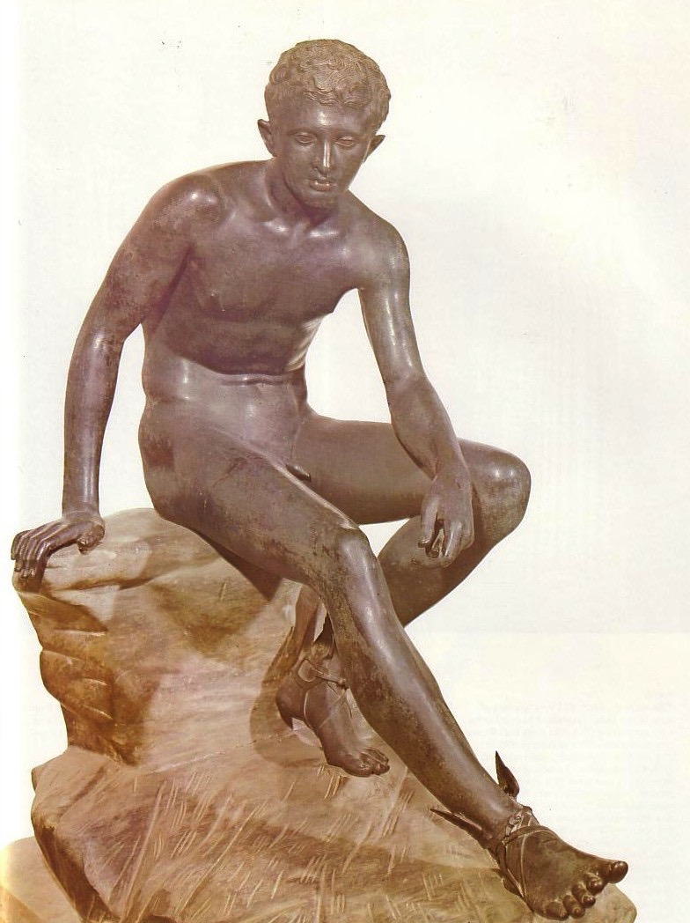
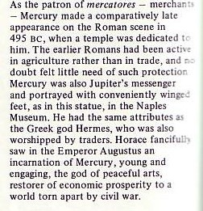
Importing gods from Greece
150
Greek god
Roman god
Hermes
Mercury
Notes:
“As the patron of mercatores—merchants—Mercury made a comparatively late appearance on the Romans scene in 495 BC, when a temple was dedicated to him. The earlier Romans had been active in agriculture rather than in trade, and no doubt felt little need of such protection. Mercury was also Jupiter’s messenger and portrayed with conveniently winged feet, as in this statue, in the Naples Museum. He had the same attributes as the Greek god Hermes, who was also worshiped by traders. Horace fancifully saw in the Emperor Augustus an incarnation of mercury, young and engaging, the god of peaceful arts, restorer of economic prosperity to a world torn apart by civil war.” —Source unknown

Slide 8
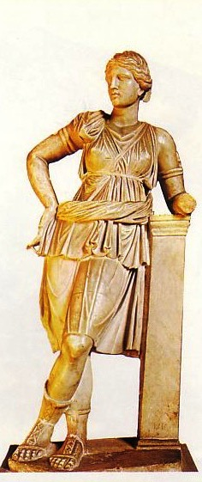
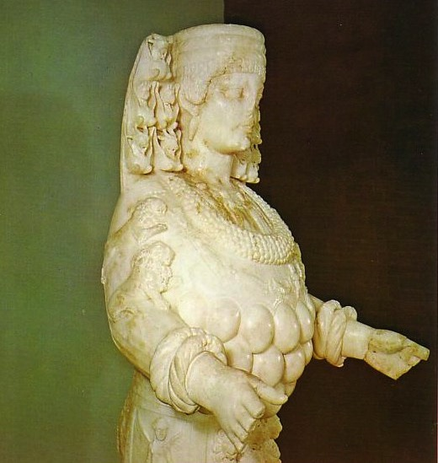
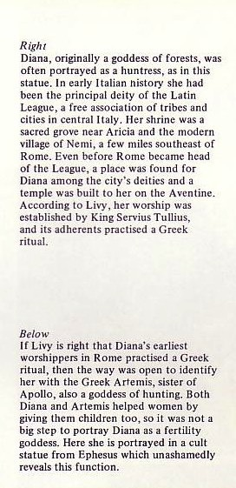
Importing gods from Greece
150
Greek god
Roman god
Hermes
Zeus
Ares
Artemis
Mercury
Jupiter
Mars
Diana

Slide 9
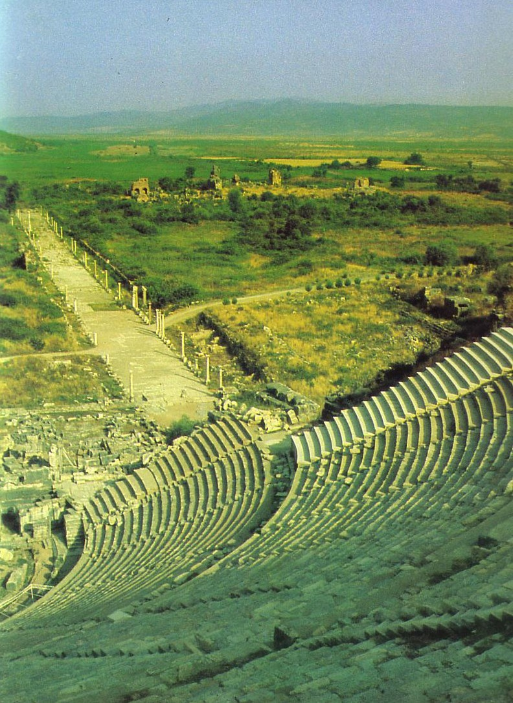
Diana Worship
Artemis
Goddess of Fertility
Originally huntress and lover of nature in classical times
"Diana" to the Romans
Many breasts (fertility)
Non-promiscuous
Mother goddess of Asia
Centered in Ephesus
Acts 19:23-41

Slide 10
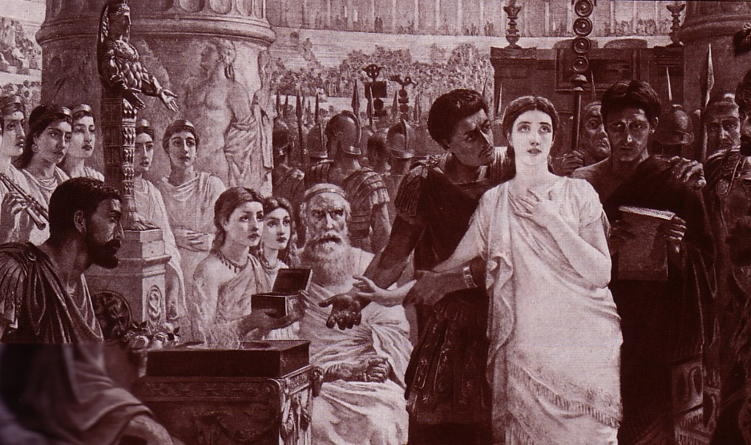
Perpetua's Martyrdom (AD 203)
Notes:
She refused to offer incense to Diana's image and thus was killed for it.

Slide 11
The Romans basically copied the Greeks to determine the types of gods to worship. They simply changed their names!

Slide 12
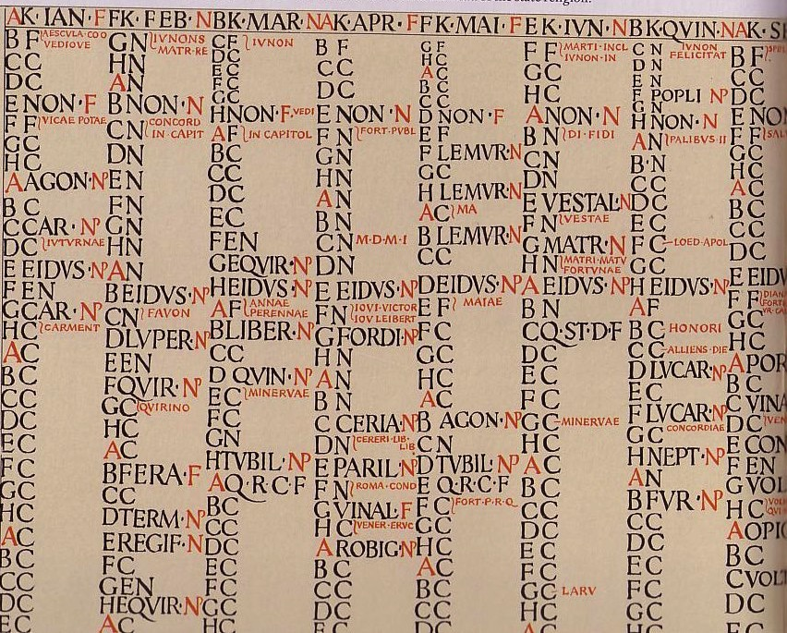
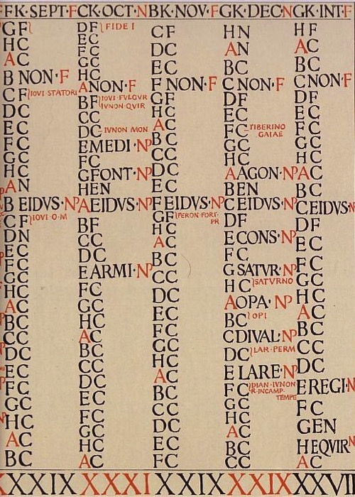
The Roman Calendar
Each Latin month led to the English name for that month
Gods of the household:
Vesta (the hearth)
The Penates (kitchen)
The Lares (departed ancestors)
Notes:
Cornell & Mathews, Atlas of the Roman World, 94-95

Slide 13
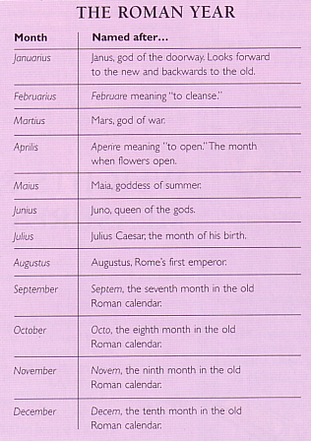
Roman Months
Month | Names after…
Januarius | Janus, god of the doorway, looks forward to the new and backwards to the old
Februarius | Februare meaning "to cleanse"
Martius | Mars, god of war
Aprilis | Aperier meaning "to open"; the month when flowers open
Maius | Maia, goddess of summer
Junius | Juno, queen of the gods
Julius | Julius Caesar's month of birth
Augustus | Augustus, Rome's first emperor
September | Septem, the 7th month in the old Roman calendar
October | Octo, the 8th month in the old Roman calendar
November | Novem, the 9th month in the old Roman calendar
December | Decem, the 10th month in the old Roman calendar
Named after…
Gods
Words
Emperors
Old Calendar

Slide 14
Year of the Dog

Slide 15
The quest of pagan man
150
Now
Then
Health
Prosperity
Protection
Victory in battle
Long life
Money
Insurance
Squash the competition!
Some things never change

Slide 16
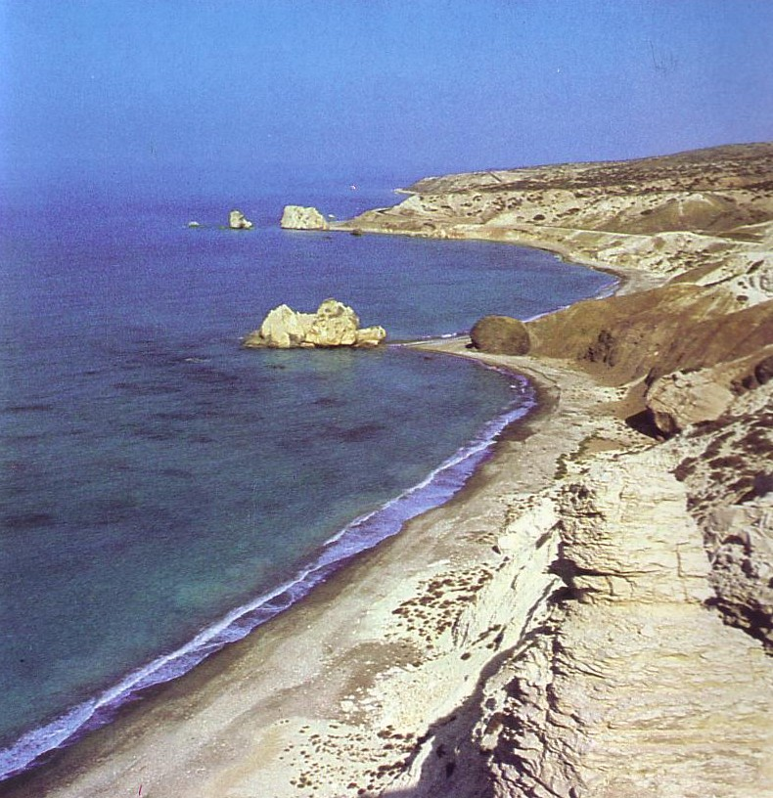
The Failure of Pagan Deities
150
Failed to fulfill their claims
Gods too human in morality
Impersonal local religion
Detachment through migration
"The coastline of Paphos on Cyprus where, according to Greek legend, Aphrodite, the goddess of love was 'born'—having risen from the foam of the sea nearby"
E. Pax, In the Footsteps of St. Paul, 65

Slide 17
Pagan Religions
151
Types of Gentile Belief Systems
Traditional Pagan Religion
Schools of Philosophy

Slide 18
Contrasting the Two…
151
Traditional Pagan Religion (vertical) | Philosophical Schools (horizontal)
polytheistic | monotheistic (though inconsistent)
corporate and local | individualistic and universalistic
strategies of appeasement (theological) | philosophies of conduct (behavioral)
akin to a religion (like Buddhism) | akin to a philosophy (like Confucianism)

Slide 19
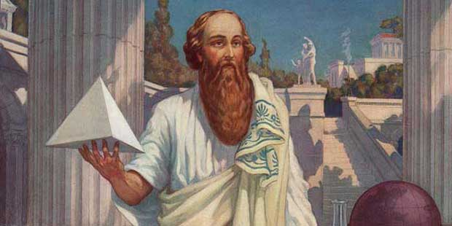
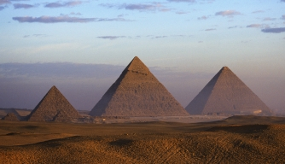
Pythagoras
Pythagorean Theorem
Basic math to design many structures
a² + b² = c²
c
a
b

Slide 20
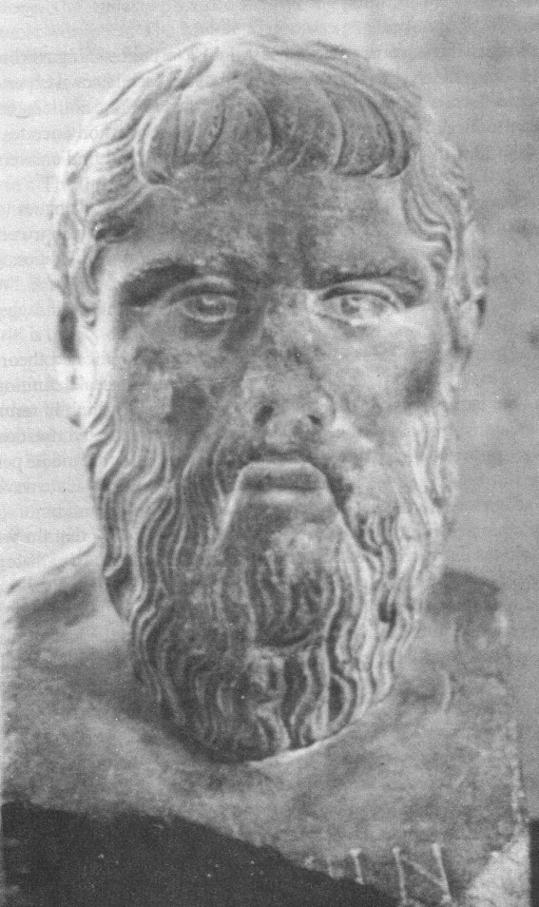
Plato
151
429-380 BC
Socratic method
Reality is in mental ideas

Slide 21
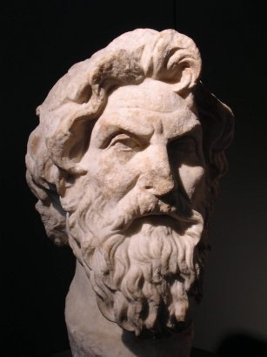
Cynics: Antisthenes
151
"Antisthenes of Athens (c. 445-c. 360 BC) is regarded as the founder of Cynicism. He was a student of Gorgias, but later he became a pupil and follower of Socrates. He usually expressed his distain for conventional values and pleasure. For Antisthenes, desire leads to pleasure and pleasure to the misery of insufficient and temporal happiness. For Antisthenes only virtue is sufficient for real happiness, that is well-being."
www.philosophy.gr/hellinistic/cynics.htm
Notes:
Antisthenes of Athens (c.445-c.360 BC) is regarded as the founder of Cynicism. He was a student of Gorgias, but later he became a pupil and follower of Socrates. He usually expressed his distain for conventional values and pleasure. For Antisthenes, desire leads to pleasure and pleasure to the misery of insufficient and temporal happiness. For Antisthenes only virtue is sufficient for real happiness, that is well-being. A virtuous person is sufficient with whatever is present and with future expectations and social conventions. According to Diogenes Laertius (Lives and Opinions of Eminent Philosophers VI ):
And the doctrines he adopted were these. He used to insist that virtue was a thing which might be taught; also, that the nobly born and virtuously disposed, were the same people; for that virtue was of itself sufficient for happiness. And was in need of nothing, except the strength of Socrates. He also looked upon virtue as a species of work, not wanting many arguments, or much instruction; and he taught that the wise man was sufficient for himself; for that everything that belonged to any one else belonged to him. He considered obscurity of fame a good thing, and equally good with labour. And he used to say that the wise man would regulate his conduct as a citizen, not according to the established laws of the state, but according to the law of virtue.
Translated by Yonge {http://www.philosophy.gr/hellinistic/cynics.htm}

Slide 22
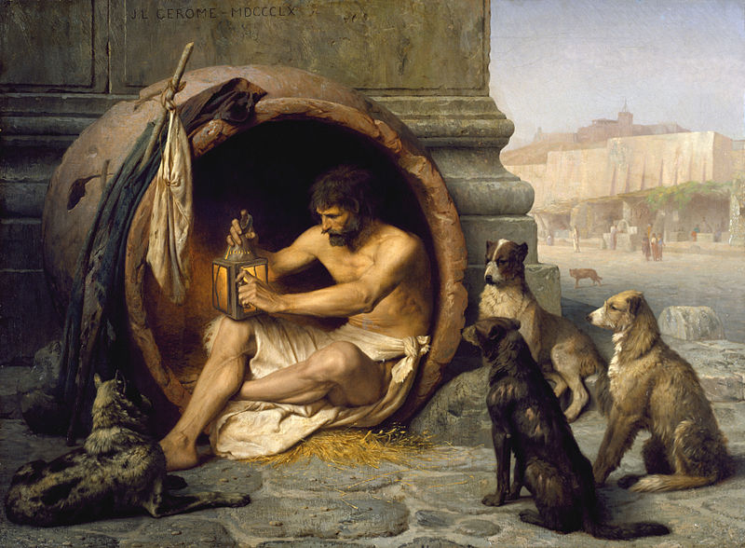
Cynics: Diogenes of Sinope
151
Notes:
Diogenes lived in a barrel (some say a bathtub) publicly, begging from people and giving wise sayings to those who came to see him.

Slide 23
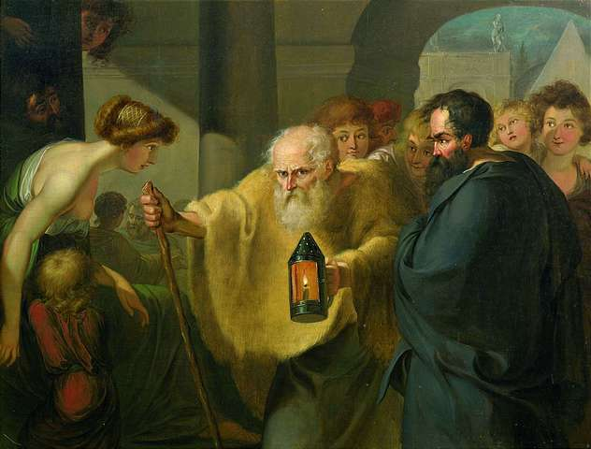
Cynics: Diogenes of Sinope
151
Notes:
Diogenes regularly took a lamp publicly to say he was looking for an honest man.

Slide 24
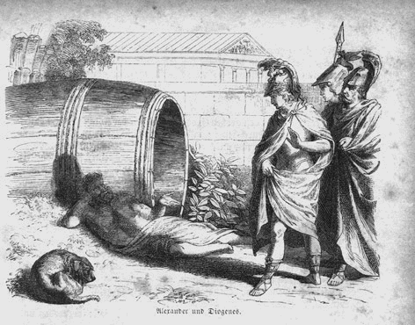
Cynics: Diogenes of Sinope
151
Notes:
"Diogenes of Sinope (c.400-c.325 BC) was a follower of Antisthenes and probably the most popular of the Cynics. Plato called Diogenes 'Socrates gone mad.' He had an extreme personality with strong views. He denied pleasure and physical wealth for asceticism. He had the nickname 'the dog' because of his shamelessness. He used to live in a barrel with only two possessions: a robe to wear and a stick to walk. There are many stories for Diogenes' rebellious and anti-conformal character. According to some ancient sources Diogenes carried a lighted lamp in broad daylight looking in the streets of Athens for the honest man. But the most famous anecdote of his life is related to Alexander the Great. When Alexander stood before him and asked him if he had any desire, Diogenes asked Alexander to move a little to one side because he was blocking the sun.
There lived a wise man in ancient Greece whose name was Diogenes. Men came from all parts of the land to see him and talk to him.
Diogenes was a strange man. He said that no man needed much, and so he did not live in a house but slept in a barrel, which he rolled about from place to place. He spent his days sitting in the sun and saying wise things to those who were around him.
When Alexander the Great came to that town he went to see the wise man. He found Diogenes outside the town lying on the ground by his barrel. He was enjoying the sun.
When he saw the king he sat up and looked at Alexander. Alexander greeted him and said:
"Diogenes, I have heard a great deal about you. Is there anything I can do for you?"
"Yes," said Diogenes, "you can step aside a little so as not to keep the sunshine from me."
The king was very much surprised. But this answer did not make him angry. He turned to his officers with the following words:
"Say what you like, but if I were not Alexander, I should like to be Diogenes."
[Retrieved from http://www.de.dau.lv/angluvaloda/ang1/node21.html]

Slide 25
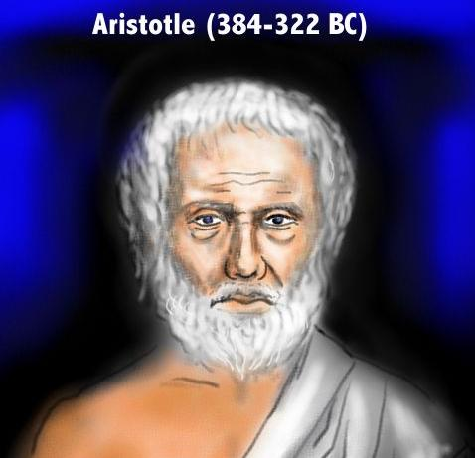
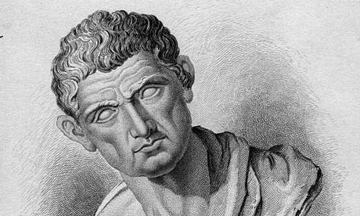
Aristotelianism
151
Aristotle (384-322 BC)
Reality is the material world (what you can see and touch)

Slide 26
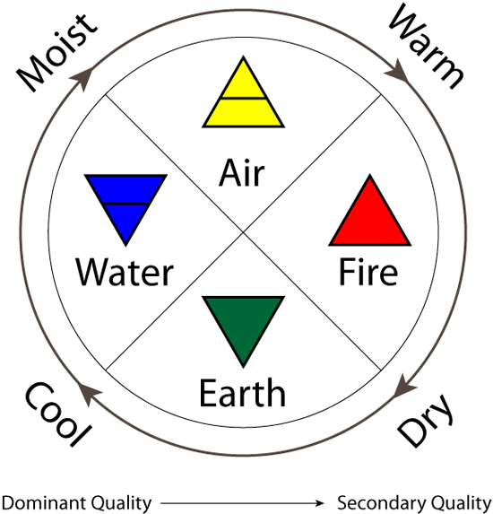
Aristotle's 4 Elements
Moist
Warm
Air
Reality = Material World
Water
Fire
Earth
Cool
Dry
Dominant Quality
Secondary Quality
Notes:
Aristotle was the first to teach the world composed of four basic elements: Fire, earth, water, and air.

Slide 27
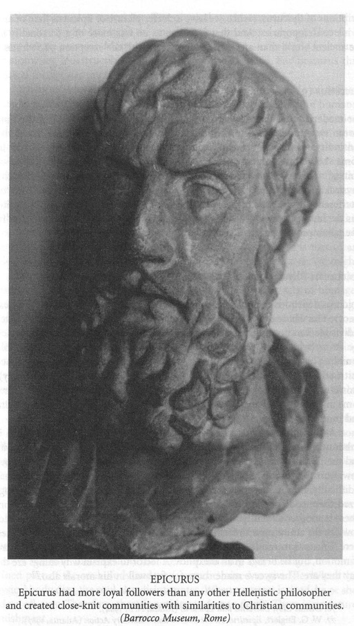
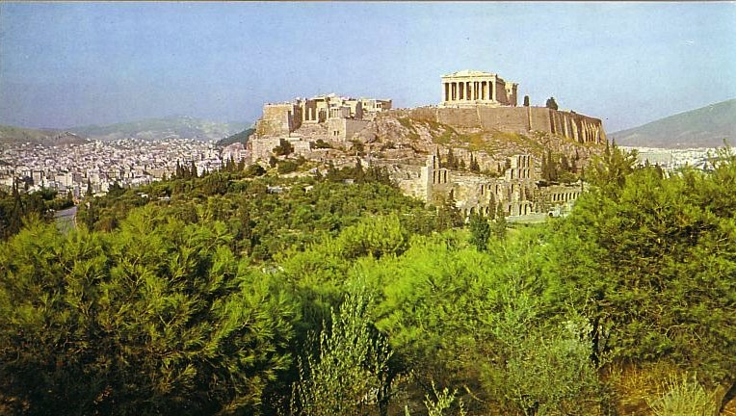
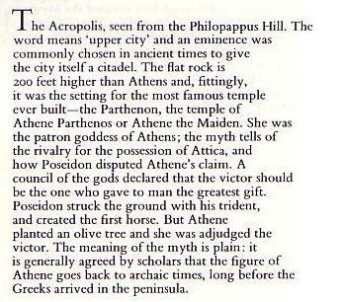
Epicureans and Stoics at the Parthenon
151
EPICURUS
Epicurus had more loyal followers than any other Hellenistic philosopher and created close-knit communities with similarities to Christian communities. (Barrocco Museum, Rome)

Slide 28
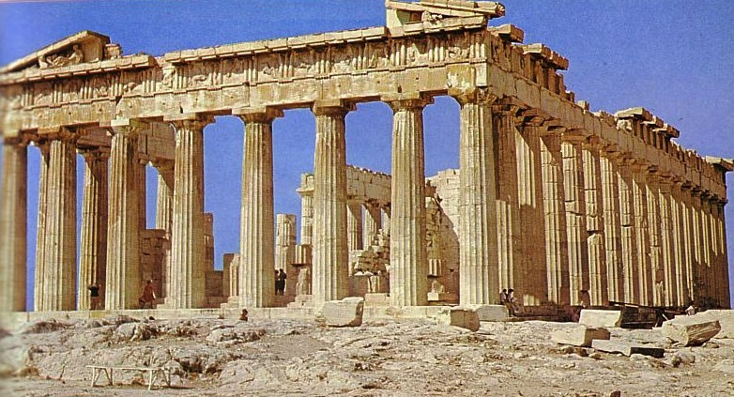
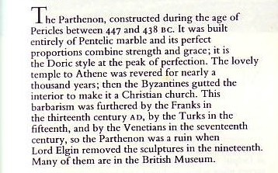
The Parthenon: Place of Debate
151

Slide 29
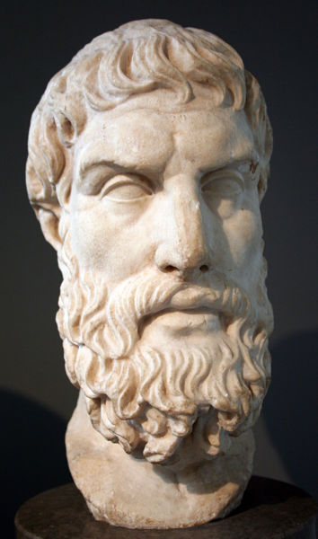
Epicureanism
151
Eat,
Drink
& Be Merry

Slide 30
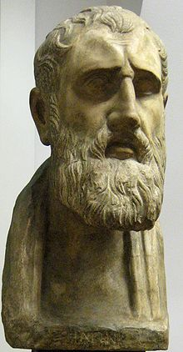
Stoicism
151
Rejected Epicureanism
"Reality is natural reason"
Cause & effect
Led to materialism
Zeno of Citium (336-264 BC)
Notes:
"The Stoics taught that destructive emotions resulted from errors in judgment, and that a sage, or person of 'moral and intellectual perfection,' would not suffer such emotions ("Stoicism," Stanford Encyclopedia of Philosophy cited at http://en.wikipedia.org/wiki/Stoicism; accessed 15 Sept 2012).

Slide 31
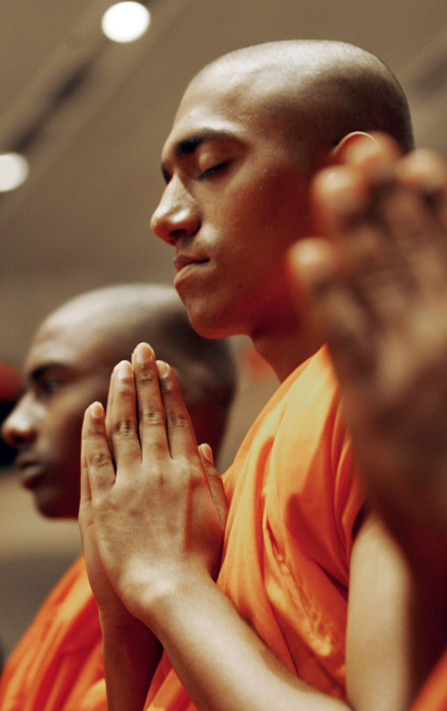
Stoicism Today
151
"Stoicism in the West, like Buddhism in the East, was a philosophy that sought not only to explain the nature of the physical world and our knowledge of it, but also to provide guidance on how to live the best life, and how to confront the challenges we all face in living."
gettingstronger.org/stoicism
Notes:
"Stoicism in the West, like Buddhism in the East, was a philosophy that sought not only to explain the nature of the physical world and our knowledge of it; but also to provide guidance on how to live the best life, and how to confront the challenges we all face in living" cited at http://gettingstronger.org/stoicism/; accessed 15 Sept 2012).

Slide 32
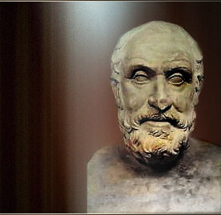
Skepticism: Pyrro of Elis
151
• Knowledge is unattainable
• Just "go with the flow"

Slide 33
Eclectics
151
"I'm a Buddhist.
I'm a Muslim.
I'm a Christian.
I'm whatever you want me to be.
It all comes down to the same thing."
Actor Jim Carrey
60 Minutes, 21 Nov 04

Slide 34
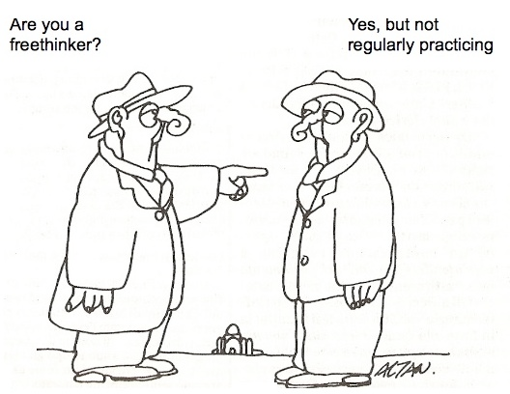
Eclectics Today = Freethinkers
Are you a freethinker?
Yes, but not regularly practicing.

Slide 35
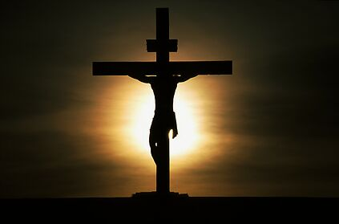
The Challenge of Greek Philosophy Against Christianity
151
Platoism
Pythogoreanism
Cynicism
Eclectics
Aristotelianism
Skepticism
Epicurianism
Stoicism

Slide 36
Pagan Religions
152
Types of Gentile Belief Systems
Traditional Pagan Religion
Schools of Philosophy
The Emperor Cult

Slide 37
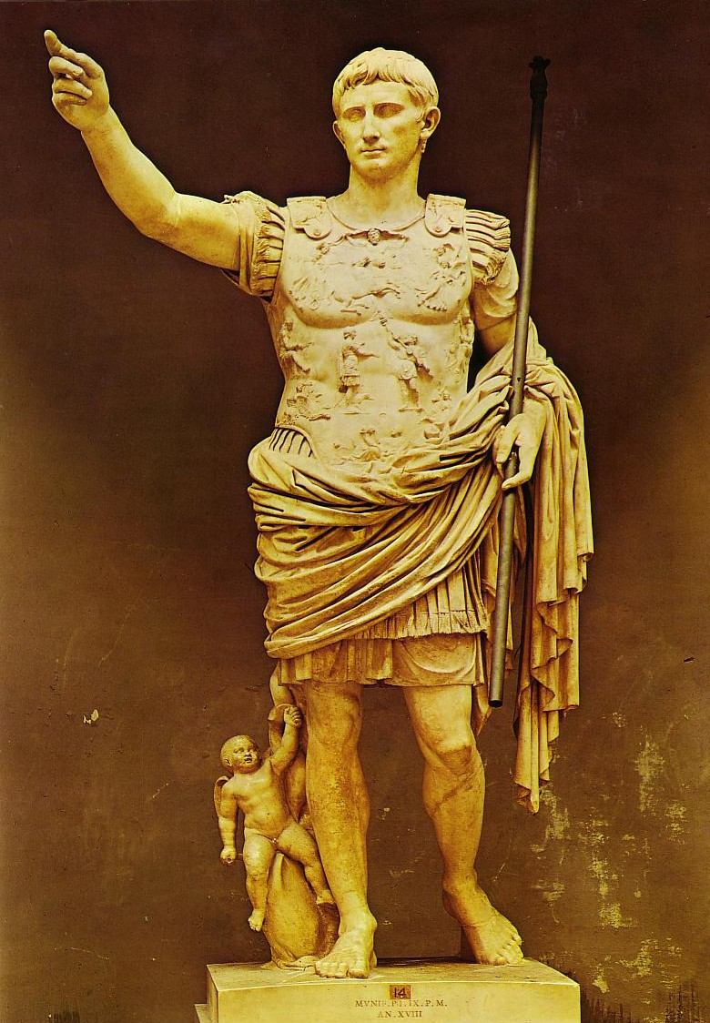
Augustus (30 BC-AD 14) was worshipped after his death
152

Slide 38
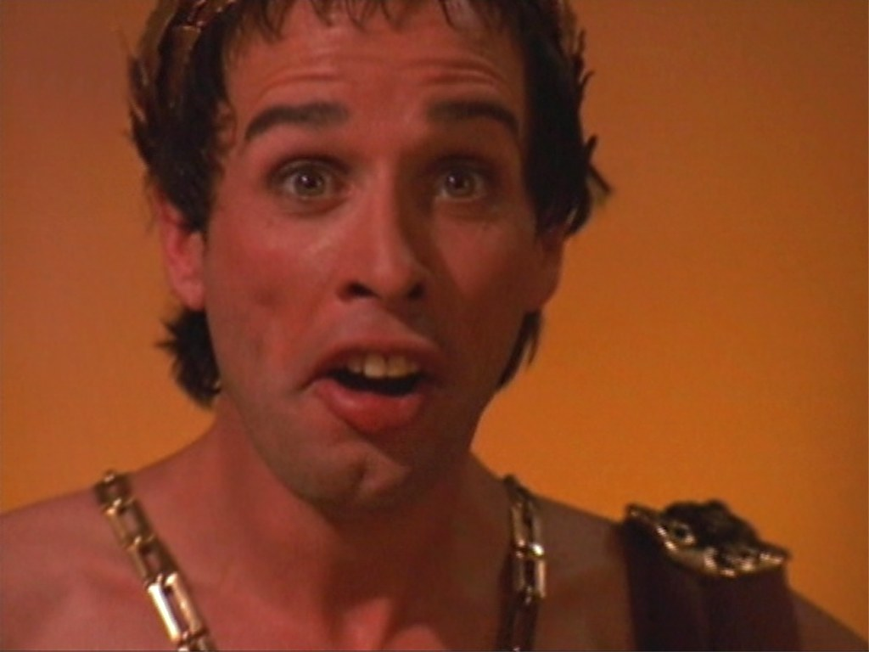
Caligula (AD 37-41)
Demanded worship while living

Slide 39
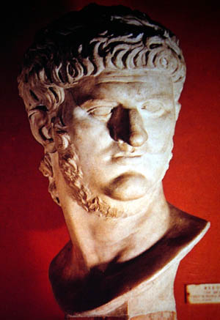
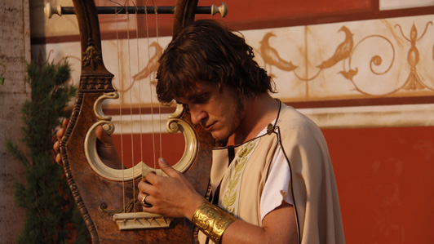
Nero (AD 54-68)
Demanded worship while emperor

Slide 40
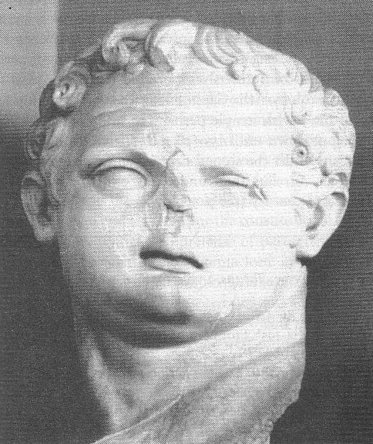
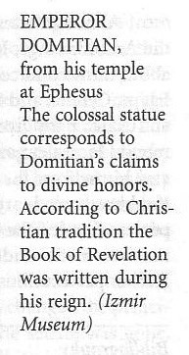
Domitian (AD 81-96)
This bust of Domitian was found in his huge temple at Ephesus—consistent with his claim to divine honors
Book of Revelation (AD 95)

Slide 41
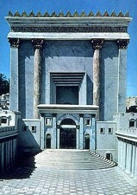
When Did John Write Revelation?
NTS 39-41, 320
Who was the Roman Emperor then?
Christ Crucified AD 33
Jerusalem Destroyed AD 70
Revelation Written AD 95
Tiberius 14-37
Caligula 37-41
Claudius 41-54
Nero 54-68
Vespasian 69-79
Titus 79-81
Domitian 81-96
Supported by: Irenaeus Victorinus of Pettau Clement of Alexandria Eusebius
Notes:
Emperors in black persecuted Christians
This course teaches that Revelation was written during the reign of Domitian at the end of the first century.

Slide 42
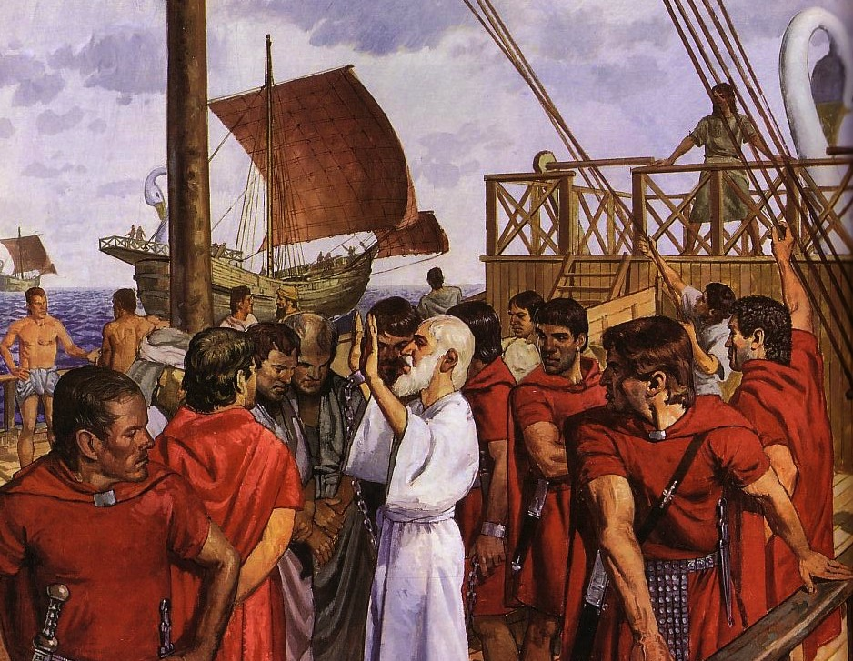
The Emperor Cult Threatened Christians
Ignatius (c. 35 – c. 107), Bishop of Antioch, refused emperor worship and was brought to Rome to be fed to wild beasts. En route he wrote seven letters.

Slide 43
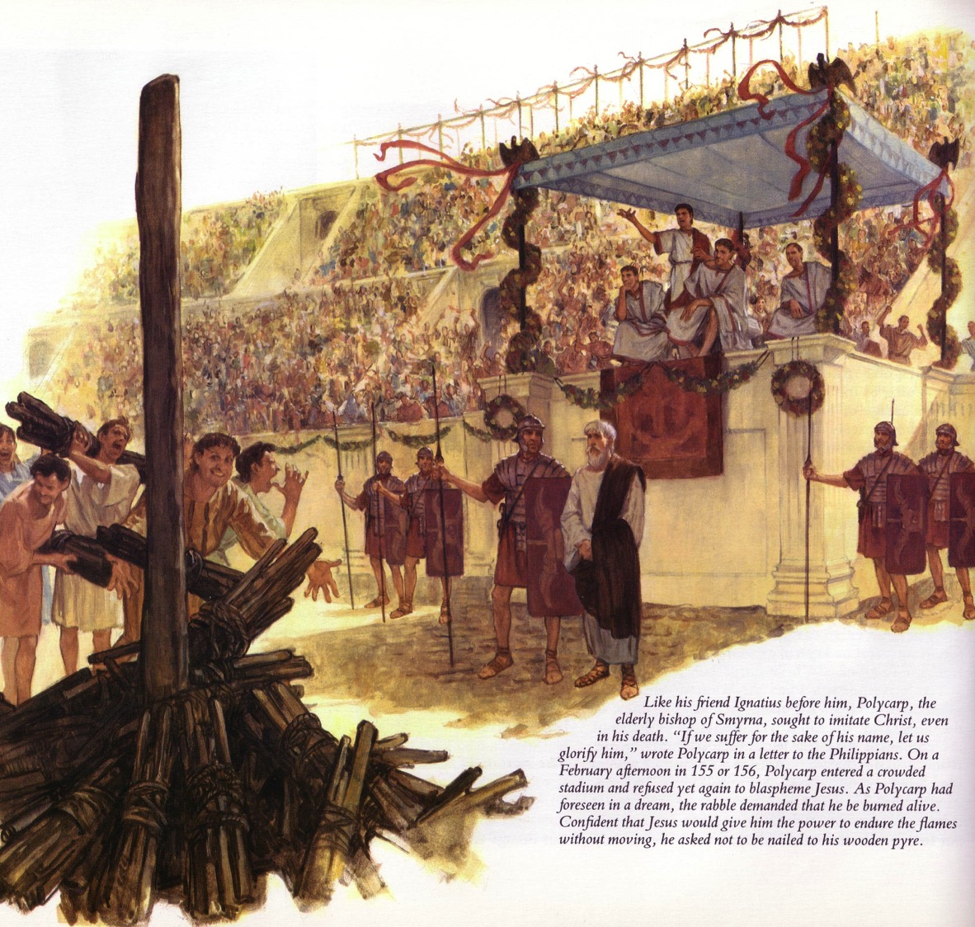
Polycarp's Martyrdom
“The blood of martyrs is the seed of the Church” (Tertullian, AD 160-225)
Notes:
“Eighty-six years I have been his servant. How can I blaspheme my King who saved me?” These words were spoken by Polycarp. Polycarp was the bishop at the church at Smyrna. Last week we looked at Ignatius. Ignatius was bishop at Antioch. Both Antioch and Smyrna were significant cities in the New Testament. And there’s another connection. Both Ignatius and Polycarp were the disciples of John. In fact there is this great legend in church history that as Ignatius was John’s disciple, and Polycarp was John’s disciple, then Polycarp was also Ignatius’ disciple. Polycarp would go on to disciple Irenaeus. And Irenaeus would go on—now here’s a great name from the early church—he would go on to disciple Hippolytus. So there we have this great length through the first two centuries of the church’s life back to John.
So here we have Polycarp and his great line. That line comes from the martyrdom of Polycarp. At eighty-six years old he was considered the enemy of the state. And Caesar himself saw to it that Polycarp would be arrested and that he would be martyred. So the arrest warrant was issued and the soldiers were dispatched and they chased down Polycarp. Polycarp fled, and at one moment he hid out, he was hiding in a sort of out-building behind an estate, and you can sort of picture him huddled behind a hay stack, and in come these Roman soldiers. You know, they were told “This guy is the enemy of the state, you need to get him.” And here they burst through the door and there he is, this eighty-six year old man. Well, Polycarp looks at them, they’ve been tracking him for days, likely hadn’t eaten, he sees how hungry they are, and he goes and orders the master of the house to prepare them food. Well they arrest him, they take him back. They day comes for his martyrdom. He is to stand in front of the crowd, and to sort of picture this in your mind you have to sort of see a Roman amphitheatre in front of you so it opens up in sort of a semi-circle in front of you. And behind Polycarp would be the Christians. Now Polycarp was ordered to turn around and say, “Away with the atheists,” as he looked to the Christians. This would be his way of recanting the faith. By saying “Away with the atheists” he would be distancing himself from the Christians. See, this has got to be one of the greatest ironies of all of history. The early Christians were accused of atheism because they denied the gods of the state. And specifically, they refused to take part in emperor worship.
So Polycarp is supposed to look behind him and say, “Away with the atheists.” Instead this is what Polycarp does. He looks at the great crowd that’s in front of him, assembled in the amphitheatre, and with one grand sweeping hand gesture, he reaches all around the crowd and he says, “Away with the atheists.” Now, I can’t help but think, but there’s a little humor in that. But we also have to be impressed by the courage. Not only should we be impressed by the courage that is in Polycarp, but we need to get a sense of his perspective on what matters.
At the very end of the martyrdom of Polycarp, there are two lines that I think we need to pay attention to. One of those lines is simply that it refers to the day of martyrdom not as a martyrdom, but it calls it “a day of victory.” And then there’s this, which actually closes it, and I’ve always found this to be insightful, it says, “Polycarp was arrested by Herod,” and isn’t it interesting that we have this political figure named Herod, and there’s clearly there a connection to the historical Jesus and the Herod that was involved in Jesus’ trial. So, “Polycarp was arrested by Herod when Philip was high priest during the proconsulship of Statius Quadratus. But while Jesus Christ was reigning as King forever.” And then it adds this—”To him be glory, honor, majesty, and the eternal throne, from generation to generation.” See Polycarp knew that Rome and Caesar, those were just the shadows, that the reality is that Jesus Christ is Lord of the Universe. And for that Lord, Polycarp was willing, not only to live for Christ, but willing to give his life for Christ.
Stay connected with 5 Minutes in Church History by getting the weekly podcast on iTunes, SoundCloud, or via RSS. You can also subscribe to the blog via RSS and follow us on Twitter and Facebook.
______
Stephen Nichols, "Two Disciples of John: Polycarp," Five Minutes in Church History
http://www.5minutesinchurchhistory.com/two-disciples-of-john-polycarp/
December 11, 2013
Accessed 6 Sep 2017

Slide 44
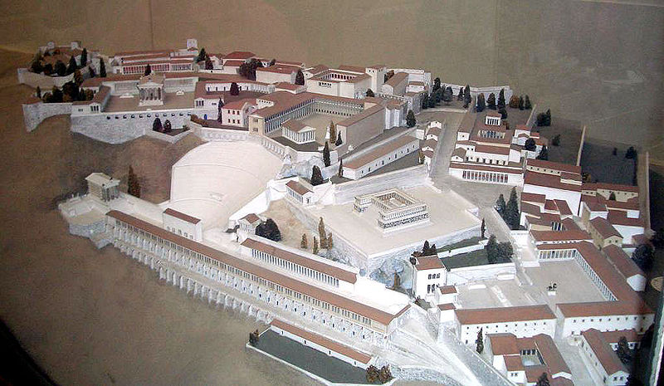
Model of Pergamum: Continuing Yet Compromising
353
Notes:
It has long been assumed that the temple was dedicated to Zeus. The altar is mentioned in the Book of Revelation, 2:11-12: "To the angel of the church in Pergamum, write this: . . . 'I know that you live where Satan's throne is . . . . '" This is a scale model of the altar.

Slide 45
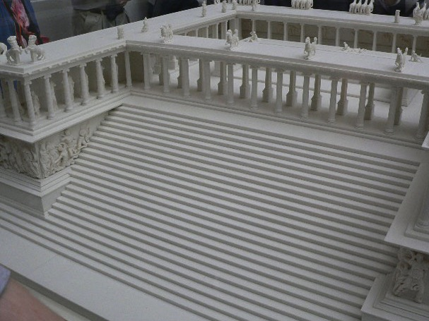
Altar of Zeus
353
"I know where you live—where Satan has his throne" (Rev 2:13)
Notes:
It has long been assumed that the temple was dedicated to Zeus. The altar is mentioned in the Book of Revelation, 2:11-12: "To the angel of the church in Pergamum, write this: . . . 'I know that you live where Satan's throne is . . . . '" This is a scale model of the altar.

Slide 46
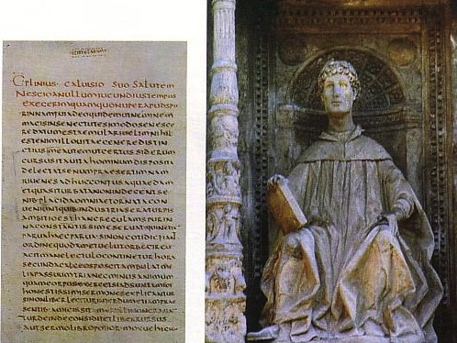
Pliny the Younger (AD 111-113)
159
He was the governor of Bithynia who wrote letters to the Emperor Trajan for counsel on various matters

Slide 47
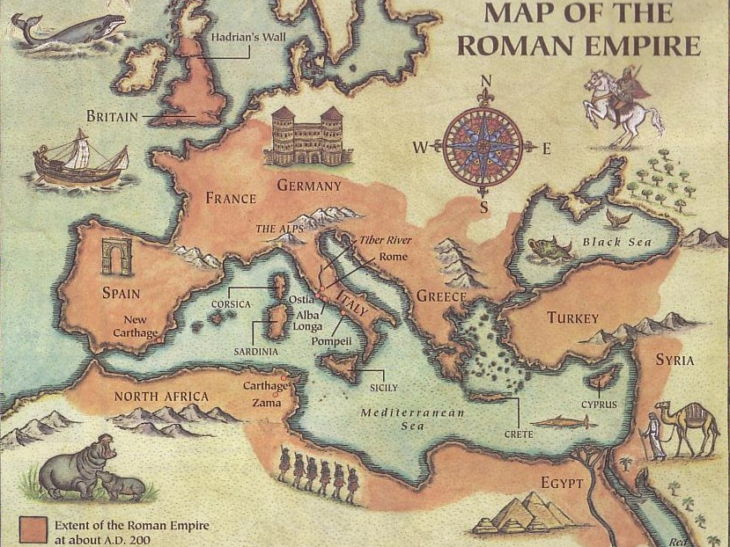
Helpful Correspondence (AD 111)
MAP OF THE ROMAN EMPIRE
Emperor Trajan in Rome
Governor Pliny in Bithynia

Slide 48
Early Church Suffering
NTS 281b
Governor Pliny to Emperor Trajan (AD 111):
I have observed the following procedure: I interrogated these as to whether they were Christians; those who confessed I interrogated a second and a third time, threatening them with punishment; those who persisted I ordered executed…
Pliny, Letters 10.96
(c)Paul Halsall Mar 1996. halsall@murray.fordham.edu http://www.fordham.edu/halsall/source/pliny1.html
Notes:
(c)Paul Halsall Mar 1996. halsall@murray.fordham.edu http://www.fordham.edu/halsall/source/pliny1.html

Slide 49
Early Church Suffering
NTS 281b
Governor Pliny to Emperor Trajan (AD 111):
I have observed the following procedure: I interrogated these as to whether they were Christians; those who confessed I interrogated a second and a third time, threatening them with punishment; those who persisted I ordered executed…
Pliny, Letters 10.96
(c)Paul Halsall Mar 1996. halsall@murray.fordham.edu http://www.fordham.edu/halsall/source/pliny1.html
Notes:
(c)Paul Halsall Mar 1996. halsall@murray.fordham.edu http://www.fordham.edu/halsall/source/pliny1.html

Slide 50
Early Church Suffering
NTS 281b
Governor Pliny to Emperor Trajan (AD 111):
Those who denied that they were or had been Christians, when they invoked the gods in words dictated by me, offered prayer with incense and wine to your image, which I had ordered to be brought for this purpose together with statues of the gods, and moreover cursed Christ—none of which those who are really Christians, it is said, can be forced to do—these I thought should be discharged.
Pliny, Letters 10.96
(c)Paul Halsall Mar 1996. halsall@murray.fordham.edu http://www.fordham.edu/halsall/source/pliny1.html
Notes:
(c)Paul Halsall Mar 1996. halsall@murray.fordham.edu http://www.fordham.edu/halsall/source/pliny1.html

Slide 51
Pagan Religions
Types of Gentile Belief Systems
Traditional Pagan Religion
Schools of Philosophy
The Emperor Cult
Mystery Religions

Slide 52
Mystery Religions

Slide 53
Greek Mystery Religion
To reach the fearful oracle of Trophonius (in central Greece), one had to climb down into a stone pit, where he was then drawn through a small opening into a dark passage. Clutching honey-cakes to feed any mythical serpents along the way, the terrified supplicant later emerged, feet first, through the same opening, having triumphantly obtained visions of the future.
Notes:
After Jesus

Slide 54
The Eleusinian Cult
Originated in Eleusis near Ephesus

Slide 55
Don't miss the obvious!
Sherlock Holmes and Dr. Watson are going camping. They pitch their tent under the stars and go to sleep. Sometime in the middle of the night, Holmes wakes Watson up: "Watson, look up at the stars, and tell me what you deduce."
Watson says, "I see millions of stars and even if a few of those have planets, it's quite likely there are some planets like Earth, and if there are a few planets like Earth out there, there might also be life."
Holmes replied: "Watson, you idiot, somebody stole our tent."

Slide 56
Mithraism
I can only let you in once you've told me the secret password, shown me your secret ring, given me the secret handshake, and…er…found the key.

Slide 57
Mithraism
Mithras (god of light) over
Ahriman (evil prince of darkness)
The worshippers dig a deep pit and the High Priest is lowered into it. Above him they put a platform of loose planks. Each plank has tiny holes drilled in it. A huge bull is stood on the platform. They take a sacred hunting spear and drive it into the bull's heart. The hot blood spurts out of the deep wound. It falls through the holes in the planks like rotten rain onto the priest below. His clothes and body are covered in the animal's gore. Afterwards he climbs out of the pit. It is a dreadful sight to see...

Slide 58
Mithraism Slaying of the Bull
At some points Mithraism was similar to Christianity

Slide 59
The Height of Mithraism (3rd Cent. AD)
MAP
At the cult's peak in the third century AD, Mithraic temples and artifacts could be found from the Black Sea to Scotland and to the borders of the Sahara Desert. Many cult members were Roman soldiers manning garrisons, especially in Italy and along the Rhine and Danube rivers.
David Ulansey, "Solving the Mithraic Mysteries," BAR 20 (Sept/Oct 94): 42

Slide 60
Egyptian Mythology
Egyptian Mythology

Slide 61
Pagan Snake Charming?
Albino Burmese Python training

Slide 62
Isis, an Egyptian goddess
White-robed followers of Isis, Egyptian goddess of life, walk behind a priestess

Slide 63
Dionysus
Roman Period
The drinking cup turned down was a sign of drunkenness.
(Eleusis Museum)

Slide 64
The Cult of Cybil
Notes:
After Jesus

Slide 65
Bronze Iron Lamp (Missing goddess Cybele on the back)

Slide 66
Corinth: Crossroads of Immorality
142
Corinth
Notes:
The route from Italy long required the treacherous sailing around the Corinthian Peninsula in order to arrive in the Aegean area to reach the heartland of Greek culture and trade.

Slide 67
Isthmus of Corinth
161a
7 km
Corinth
Acrocorinth
Temple of Aphrodite
Notes:
However, in the years before Christ, an ingenious business of ship transport developed. Sailors would disembark on one side of the Isthmus of Corinth, the ships would be put on logs and specialized crews rolled them on land the entire seven kilometers to the other side. This gave the sailors a few days off, so they visited nearby Corinth and then met their ship a few days later on the other side of the isthmus.

Slide 68
View of Acrocorinth from the City
Notes:
It takes little imagination what sailors would do with a few days off and nothing to do. Ancient Corinth was a city of so-called “free sex.” The foreground has remains of the ancient city, while in the distance is Acrocorinth, the place of the ancient temple.

Slide 69
Immorality in All Seasons
Notes:
On top of Acrocorinth, a temple was open all year for so-called “worship” with one of the 1000 temple prostitutes.

Slide 70
Temple of Aphrodite
Notes:
Sex with a temple priestess of Aphrodite was a so-called union with the goddess.

Slide 71
Temple of Aphrodite
Greek Goddess of Love
Notes:
She was the goddess of love, so sailors who visited Corinth had a few days of “liberty” with her priestesses to alleviate the boredom of a generally calm life at sea.

Slide 72
Meaningless Worship
"If I speak with the tongues of men and angels but do not have love, I am a noisy gong or a clanging cymbal" (1 Cor. 13:1)

Slide 73
Pagan Religions
Types of Gentile Belief Systems
Traditional Pagan Religion
Schools of Philosophy
The Emperor Cult
Mystery Religions
Astrology & Superstition

Slide 74
Astrology
153
"Chance!"
1,099 couples to tie the knot on V-Day
Notes:
Greek astrologers greeted one another with the word, "Chance!"
Christians greeted one another with "Maranatha!" (Aramaic for "The Lord comes!")

Slide 75
Words Christians Shouldn't Use
Profanities, of course
Fortunate
Lucky
Fate
Accident
Chance

Slide 76
"I saw altars to many gods —even to the unknown god" (Paul in Acts 17)
Prayers for slaughtered chickens
The Parthenon above the other altars in Athens
“More than 70 Buddhist monks joined Abbot Wing Sink in a seven-day chanting marathon in Hong Kong yesterday to appease the souls of more than a million chickens, slaughtered since Monday to rid the territory of the deadly ‘bird flu’ virus. The Abbot entreated more than one million Buddhists in Hong Kong to join in the prayers.” —Reuters picture, The Straits Times, Thursday, January 1, 1998
Notes:
“More than 70 Buddhist monks joined Abbot Wing Sink in a seven-day chanting marathon in Hong Kong yesterday to appease the souls of more than a million chickens, slaughtered since Monday to rid the territory of the deadly ‘bird flu’ virus. The Abbot entreated more than one million Buddhists in Hong Kong to join in the prayers.” —Reuters picture, The Straits Times, Thursday, January 1, 1998

Slide 77
Pagan Religions
Types of Gentile Belief Systems
Traditional Pagan Religion
Schools of Philosophy
The Emperor Cult
Mystery Religions
Astrology & Superstition
Gnosticism

Slide 78
Gnosticism: Perplexing Questions
153a
How can the existence of creation be explained?
What is the origin of evil?
How can a holy God create a universe with sin?
Chart 43
John D. Hannah, Charts of Ancient & Medieval Church History (Grand Rapids: Zondervan, 2001)
Notes:
Text from Hannah for this chart:
"The Christian faith was opposed by numerous adversaries––threats from the state, ominous false religions, and heretics within its own borders. The most imposing religious threat came from Gnosticism, which was particularly dangerous because of its intellectual coherency. While Gnosticism seemed to provide answers to perplexing questions, it succeeded only in mixing a snippet of biblical truth with error."

Slide 79
Essential Components of Gnosticism
153b
God (Pure Spirit)
(1) Dualism
(2) Emanations
(3) Knowledge
Demiurge
World
Man
Chart 44
John D. Hannah, Charts of Ancient & Medieval Church History (Grand Rapids: Zondervan, 2001)
Notes:
Text from Hannah for this chart:
"Gnosticism taught (1) that there is a radical dualism of the spiritual in opposition to the material (God, who is Spirit, is the supreme good, while matter is evil); (2) that God could not have created matter because it is contrary to his nature; rather, the world, which is material and evil, was created by the Demiurge (an emanation from God), and man is a material being with an entrapped spirit; and (3) that through a "secret knowledge," salvation becomes the life of escape from the material confines of the body."

Slide 80
Gnosticism's Concept of Salvation
153c
Spirit
Supreme Being "Good"
Gnosis
Soul
Body
Man
Demiurge
Chart 45
John D. Hannah, Charts of Ancient & Medieval Church History (Grand Rapids: Zondervan, 2001)
Notes:
Text from Hannah for this chart [animation brackets mine]:
"Gnosticism's concept of salvation is as follows: God did not create the world, [1] but a lesser yet powerful being (the Demiurge) made this evil world and [2] mankind––though within man is a spark of good. [3] Salvation results from enlarging the capacity of that nature while minimizing the hold of materialism, [4] and it is accomplished by means of the secret teachings of Gnostic teachers. In resisting this teaching, Christian writers adopted a worldview that embraced the God of the Bible as the divine creator, affirmed the creation as good though marred by a subsequent devastation, and espoused the salvation of the body as well as the soul."

Slide 81
Two Types of Gnosticism are Addressed in 1 John
153
Docetic Gnosticism
From dokeo, "to seem" (Christ only seemed to be a man)
Matter is Evil
Depreciated Materialism
Denied Christ's Humanity
Touched Jesus (1:1)
Led to Asceticism
Immorality exalted
Cerinthian Gnosticism
From Cerinthus, founder in Asia (Christ only seemed to be God)
Spirit is Good
Exalted Knowledge (gnosis)
Denied Christ's Deity
Water & Blood (5:6)
Led to Pride
Education exalted
Notes:
Many Gnostics did the opposite of Dan Brown's thesis in The Da Vinci Code--they denied Jesus was a real man. Others exalted the spirit so much that they denied his deity. Brown supposes that this latter heretical group was normative Christianity!

Slide 82
INCEPTION
Notes:
The July 2010 film INCEPTION blurs the distinction between reality and dream.

Slide 83
INCEPTION teaches dreams within dreams
Notes:
By espousing dreams within dreams, it encourages suicide to get one out of the dream into reality. When one of the key characters, Mal, finally does this to make it back to the real world, she still thinks it is a dream. Christianity, in contrast, teaches us to deal with reality.

Slide 84
Buddhism encourages lack of all desire
Notes:
Buddhism likewise seeks to attain the unattainable by asking us to desire not to have any desire!

Slide 85
The Apostle's Creed
153e
Notes:
The Apostle's Creed was the earliest doctrinal formation outside of the NT. It was written sometime between the 1st and 3rd centuries as an affirmation against Gnosticism. Since it was believed to come from the teaching of the 12 apostles themselves, it became known as The Apostle's Creed. There is only one Latin version but at least 6 English translations. I will share the Lutheran version.

Slide 86
The Apostle's Creed
I believe in God, the Father Almighty,
maker of heaven and earth.
153e
Jesus didn't just become "the Christ" at his baptism, as Gnostics claimed. He was conceived by the Spirit.
Gnostics taught that the world was created by a Demiurge since it is material and "therefore evil"
And in Jesus Christ, his only Son, our Lord,
who was conceived by the Holy Spirit,
and born of the virgin Mary,
suffered under Pontius Pilate,
was crucified, died and was buried.
Christ must have really been a man since he was born, he suffered, and he died.
His death was not myth but in history during Pilate's rule (AD 26-36).

Slide 87
The Apostle's Creed
Christ's resurrection was bodily, in contrast to "spiritual resurrection" of the Gnostic Gospel of Thomas.
153e
He descended into hell.
On the third day He rose again from the dead.
He ascended into heaven and sits at the right hand of God the Father Almighty.
From thence He will come to judge the living and the dead.

Slide 88
The Apostle's Creed
Instead of salvation by "special knowledge" (gnosis) for only a special few, all saints in the universal ("catholic") church hold these truths.
153e
I believe in the Holy Spirit,
the holy Christian church,
the communion of saints,
We don't need enlightenment from our ignorance. We need forgiveness of our sins.
the forgiveness of sins,
the resurrection of the body,
and the life everlasting. Amen.
Not just our spirits will join God after death. Heaven is a physical place where we will physically dwell with God for eternity.

Slide 89
Pagan Religion Today
Basic issues addressed…
Who is God?
Who am I?
What is the path to God?
How many chances for salvation do I get?
What is sin?
How can I be cleansed from sin?

Slide 90
Hindu "Hope" of Cleansing from Sin
DANGEROUS DIP
Hindu holy men shun dirty Ganges

Slide 91
NT Backgrounds link at BibleStudyDownloads.org
Get this presentation for free!
Notes:
NT Backgrounds (nb)

Slide 92
Black

